Slide 1


Deep Learning
Gehad Hisham

Slide 2

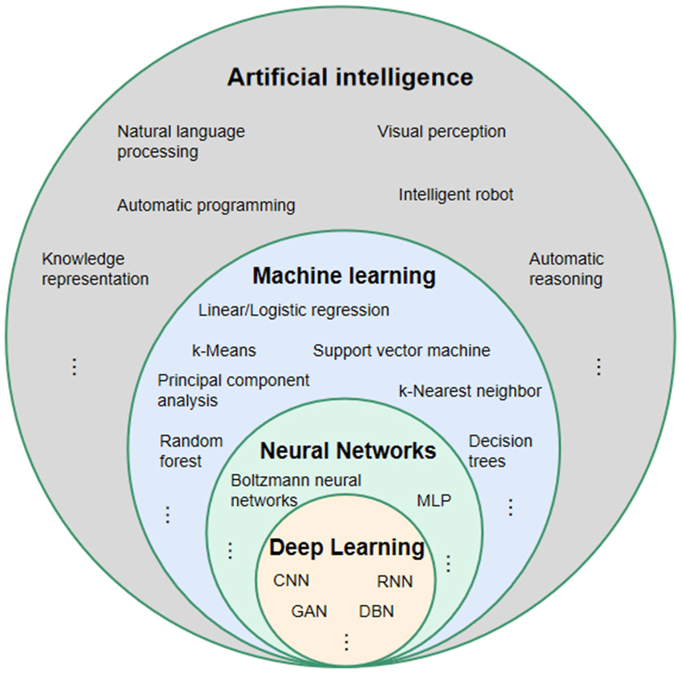

Slide 3


Slide 4
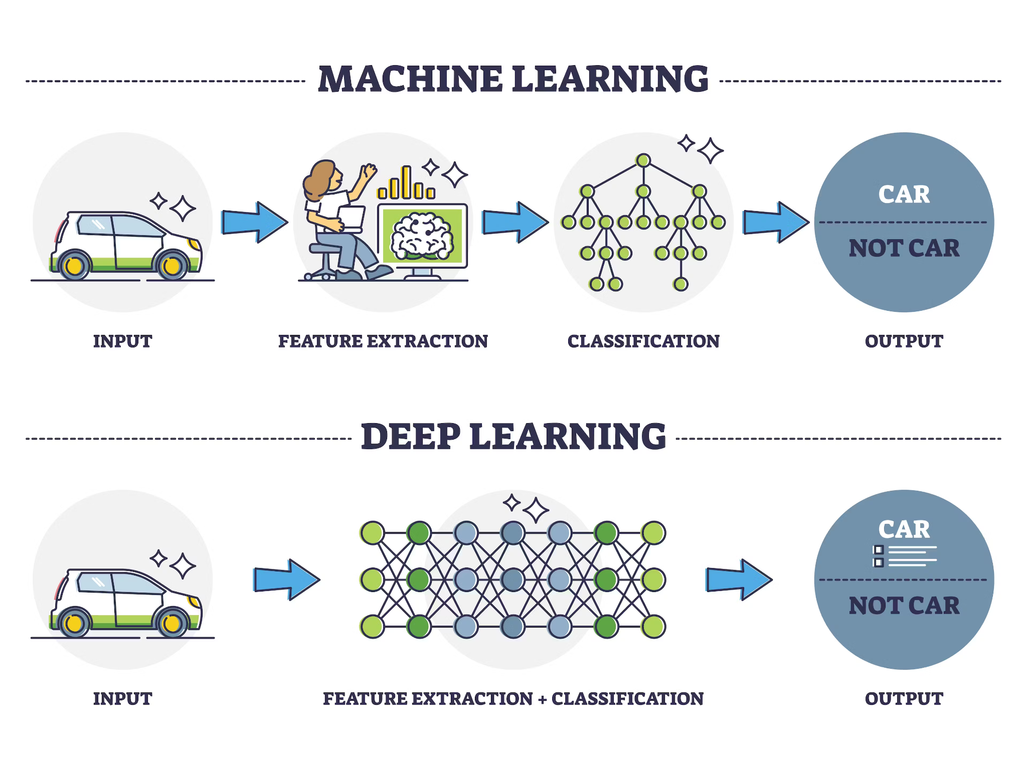

Slide 5
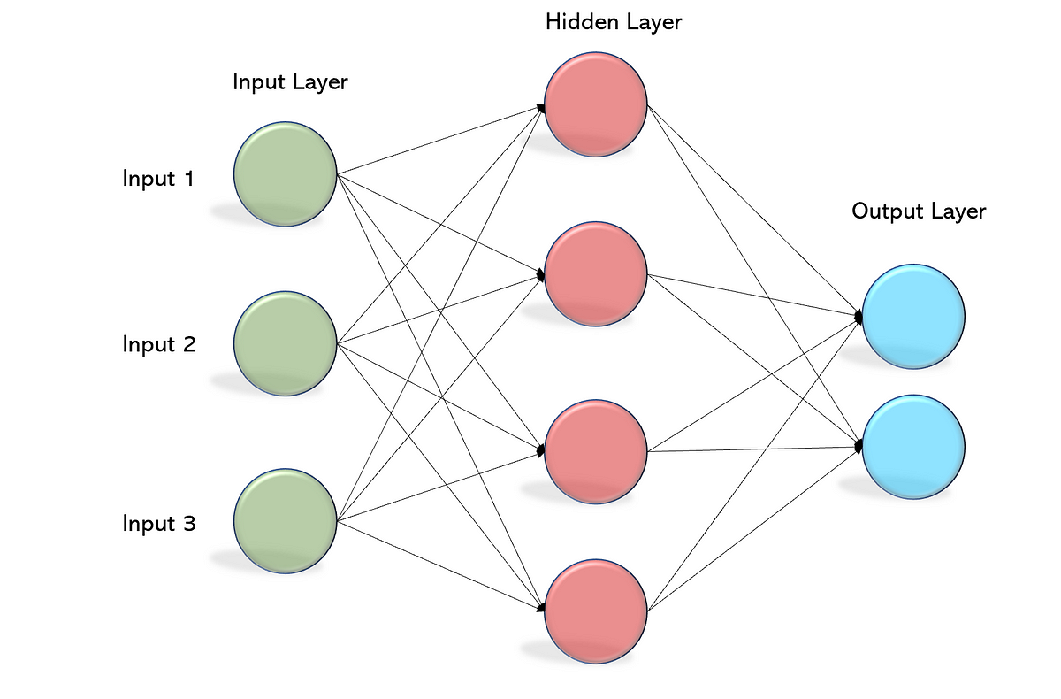
Neural Network
Take in data as input.
Train themselves to understand patterns in the data.
Output useful prediction.

Slide 6
The Learning Process of a Neural Network

Slide 7
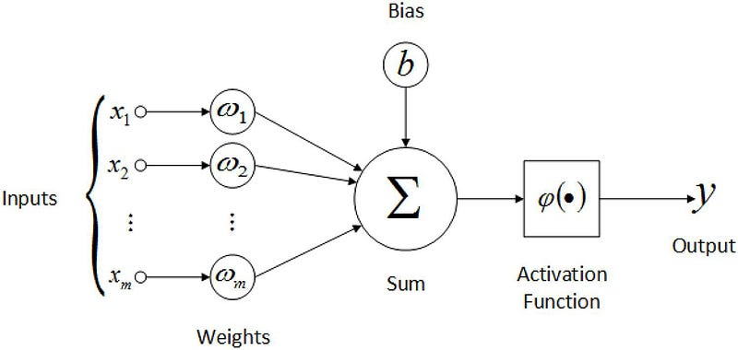
1
Forward Propagation
Weight: How important is that neuron.
Bias: opinion to that relationship,
Shift the activation function toyhr right or the left.

Slide 8
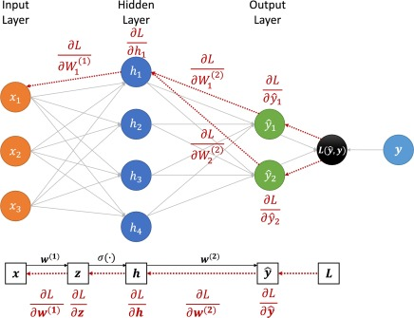
2
BackPropagation:

Slide 9

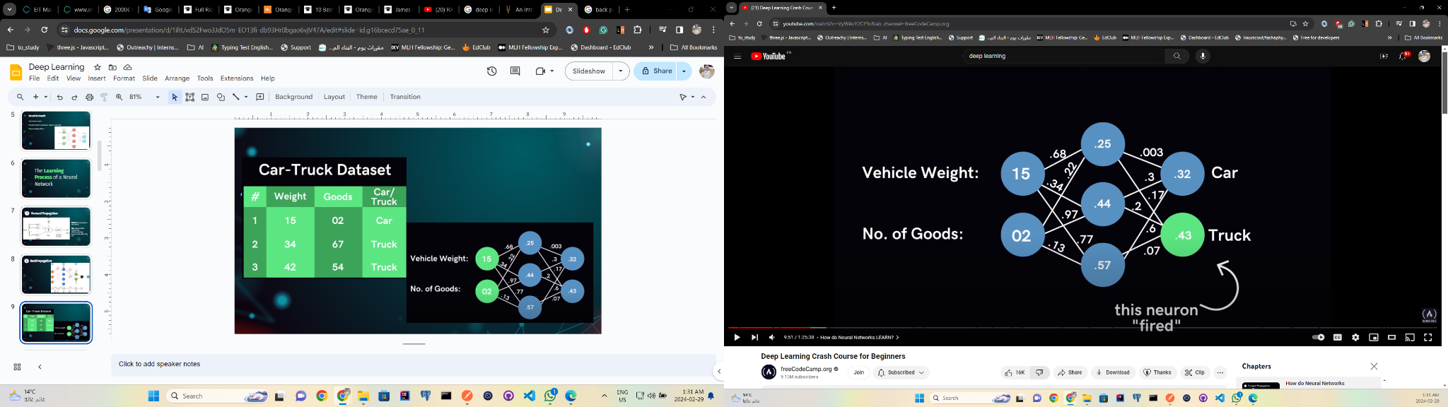

Slide 10
Improving:
Use a Loss Function.
Go backwards & adjust initial weights and biases.
Values adjusted to better fit prediction model.

Slide 11

Terms Used In Neural Networks

Slide 12
1
Activation Function
Introduce Non-Linearity in the Network.
Decide whether a neuron can contribute to the next layer.
But, how we decide if a neuron can fire/activate or not?

Slide 13
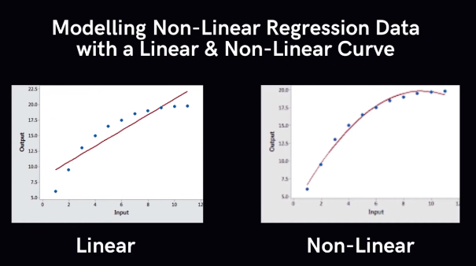

Slide 14
a.
Step Function
If value > 0 → Activate
else → Do not activate
0 is the “threshold”

Slide 15
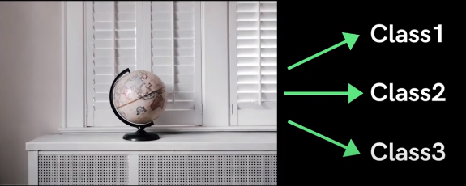
Binary Activation?

Slide 16
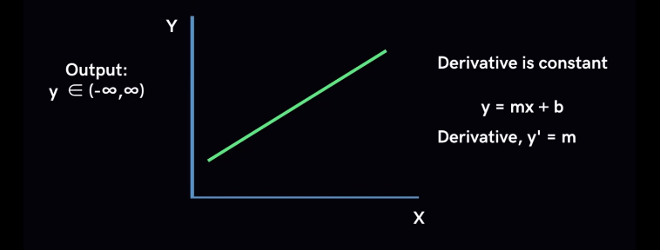
b.
Linear Function

Slide 17
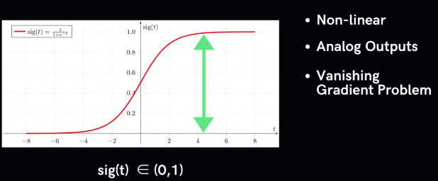
c.
Sigmoid Functions
Binary Classification

Slide 18
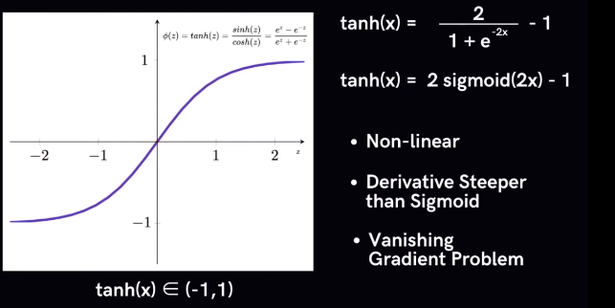
d.
Tanh Function

Slide 19
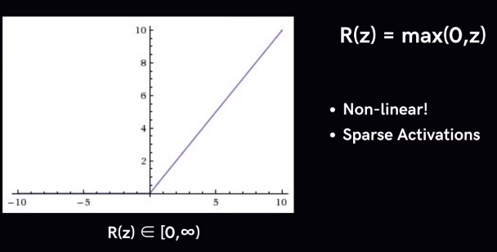
c.
RelU Function

Slide 20
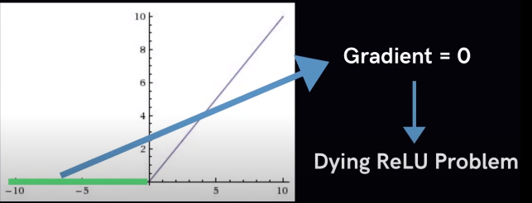

Slide 21
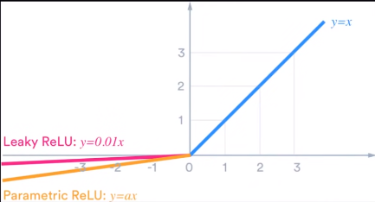
c.
Leaky RelU Function

Slide 22
2
Optimizers
During training, we adjust the parameters to minimize the loss function and make our model as optimized as possible.
But, How do we do that?
Updating the network based on the output of the loss function.

Slide 23
Epoch – The number of times the algorithm runs on the whole training dataset.
Sample – A single row of a dataset.
Batch – It denotes the number of samples to be taken to for updating the model parameters.
Learning rate – It is a parameter that provides the model a scale of how much model weights should be updated.
Cost Function/Loss Function – A cost function is used to calculate the cost, which is the difference between the predicted value and the actual value.
Weights/ Bias – The learnable parameters in a model that controls the signal between two neurons.

Slide 24
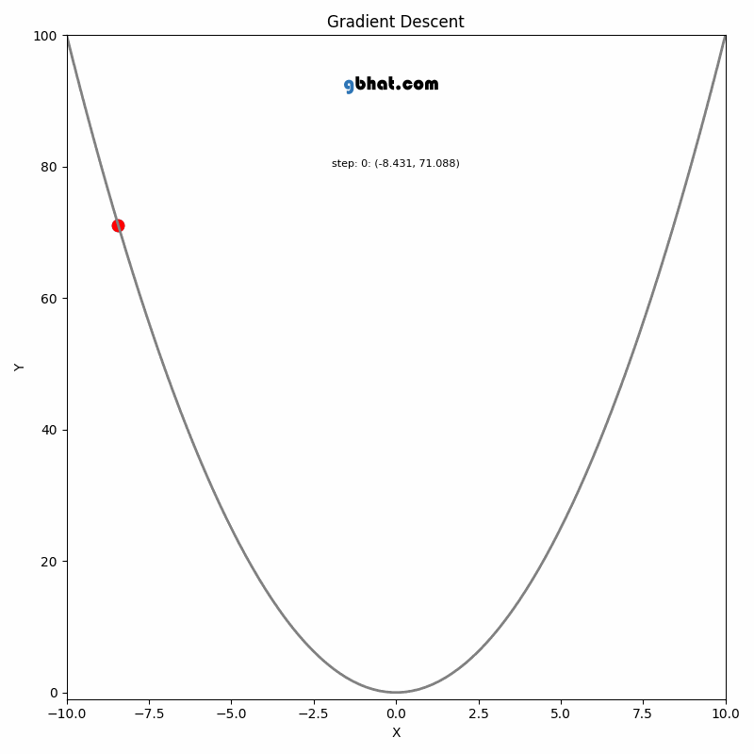
Gradient Descent
Gradient descent works as follows:
It starts with some coefficients, sees their cost, and searches for cost value lesser than what it is now.
It moves towards the lower weight and updates the value of the coefficients.
The process repeats until the local minimum is reached. A local minimum is a point beyond which it can not proceed.

Slide 25
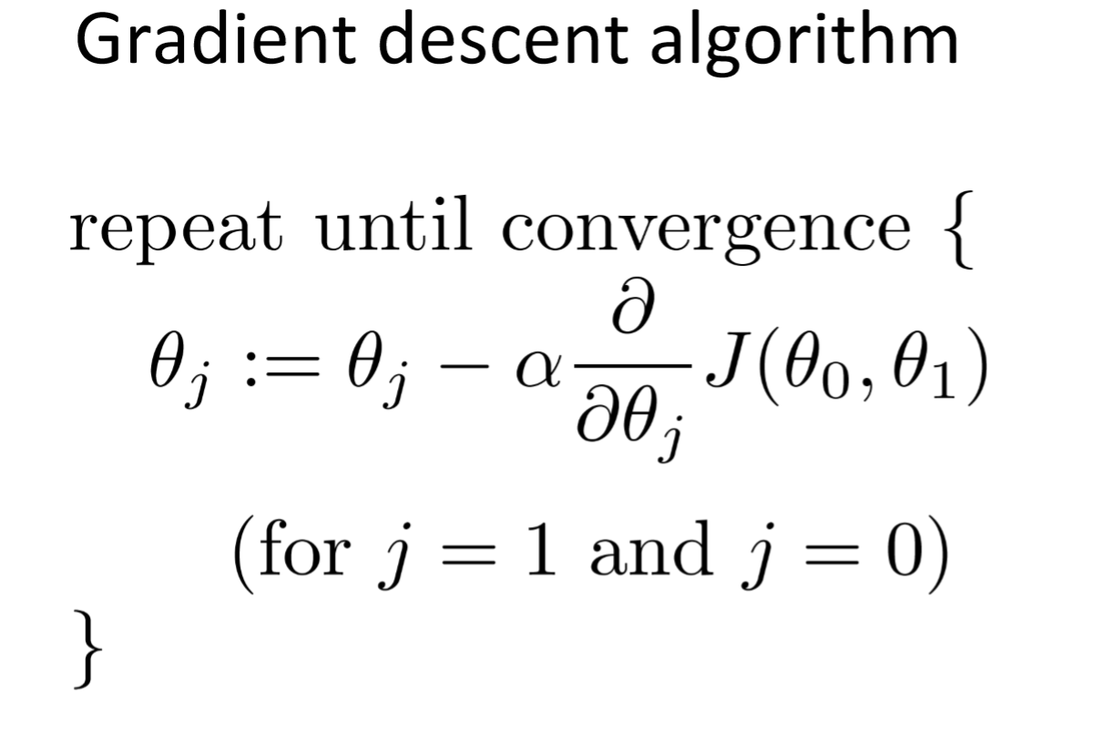

Slide 26
Batch Gradient Descent
BGD is a variation of the gradient descent algorithm that calculates the error for each data point in the training datasets, but only updates the model after all training examples have been evaluated. Takes 1 iteration.
Stochastic Gradient Descent
For an Epoch take a random data point from dataset and calculate its loss then update the weights and repeat over the rest of the data until the epoch is done, it’s causes a stochastic conversion but uses less memory. Takes N iterations.
Mini Batch Gradient descent
MGD is a variation of the gradient descent algorithm that splits the training datasets into small batches that are used to calculate model error and update model coefficients. Takes Number of Batches iterations.

Slide 27
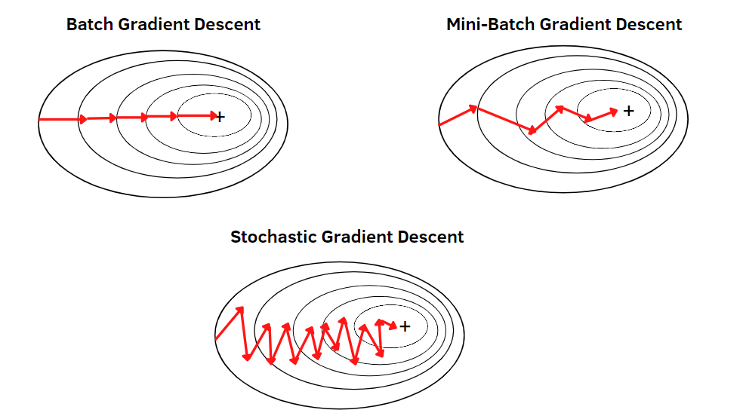

Slide 28
Gradient Descent
Standard optimization algorithm for minimizing a loss function.
Updates parameters in the opposite direction of the gradient of the loss function with respect to the parameters.
Learning rate is a fixed hyperparameter that controls the size of the update steps.
Can be slow and inefficient, especially in high-dimensional or ill-conditioned optimization problems.

Slide 29
2. Gradient Descent With Momentum
What the momentum does is helps in faster convergence of the loss function.
Stochastic gradient descent oscillates between either direction of the gradient and updates the weights accordingly. However, adding a fraction of the previous update to the current update will make the process a bit faster.
One thing that should be remembered while using this algorithm is that the learning rate should be decreased with a high momentum term.

Slide 30
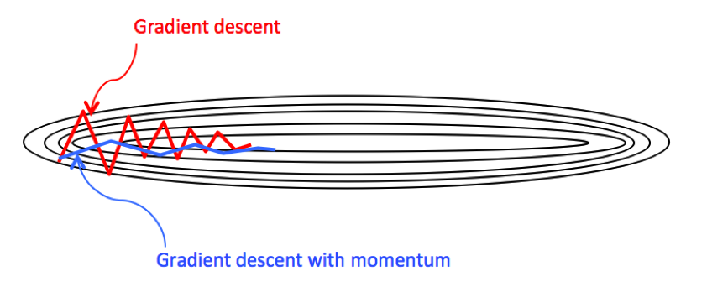

Slide 31
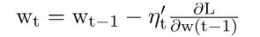
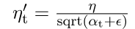
3. Adagrad (Adaptive Gradient Descent)
Adapts the learning rate for each parameter based on the history of gradients for that parameter.
Divides the learning rate by the square root of the sum of squared gradients for each parameter.
Automatically reduces the learning rate for parameters that have large gradients and increases it for parameters with small gradients.
Well-suited for sparse data or when dealing with features with different frequencies.

Slide 32
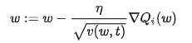
3. RMSprop
RMSprop also adapts the learning rate for each parameter based on the root mean square of past gradients for that parameter.
It divides the learning rate by a running average of the magnitudes of recent gradients, which helps in reducing the learning rate for parameters that have large gradients and increasing it for parameters with small gradients.
RMSprop addresses the problem of Adagrad's aggressive and monotonically decreasing learning rate by using a decaying average of squared gradients.

Slide 33
4. Adam(Adaptive Momentum Estimation)
Combines the ideas of momentum and adaptive learning rates.
Maintains both a decaying average of past gradients (like momentum) and a decaying average of past squared gradients (like Adagrad).
Computes individual adaptive learning rates for different parameters.
Generally performs well across a wide range of deep learning architectures and hyperparameters.

